Slide 1
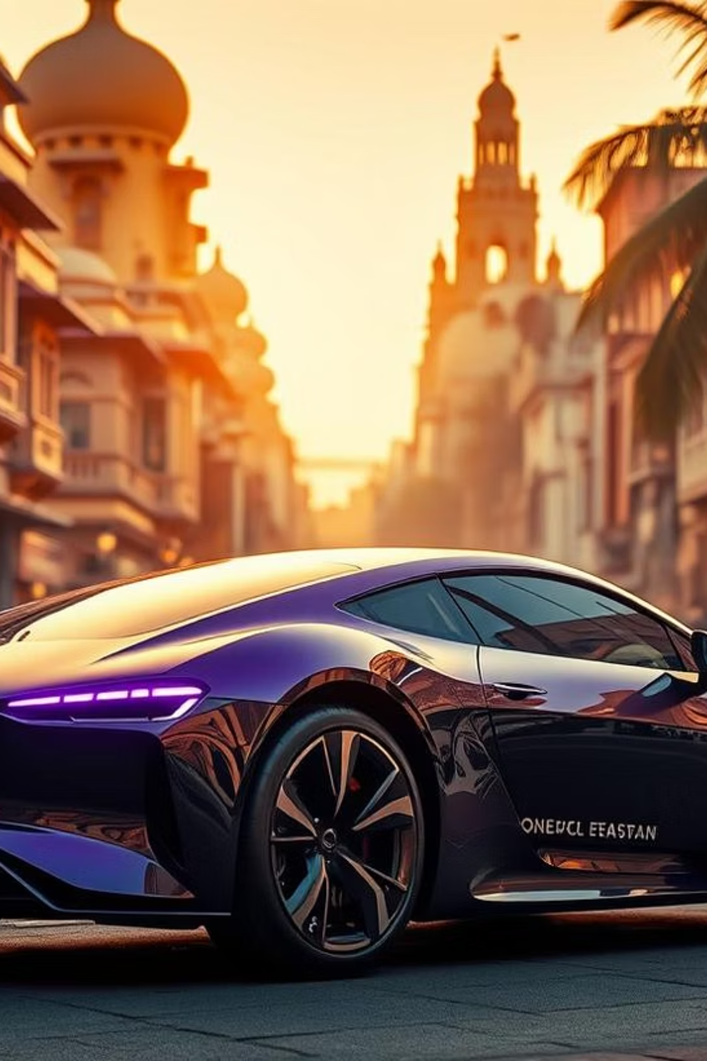
Electric Vehicle Sales by State in India
Exploratory Data Analysis & Future Forecasting
Presented by: GOONDAM RAMALINGAM VENKAT
Date: [Presentation Date]

Slide 2
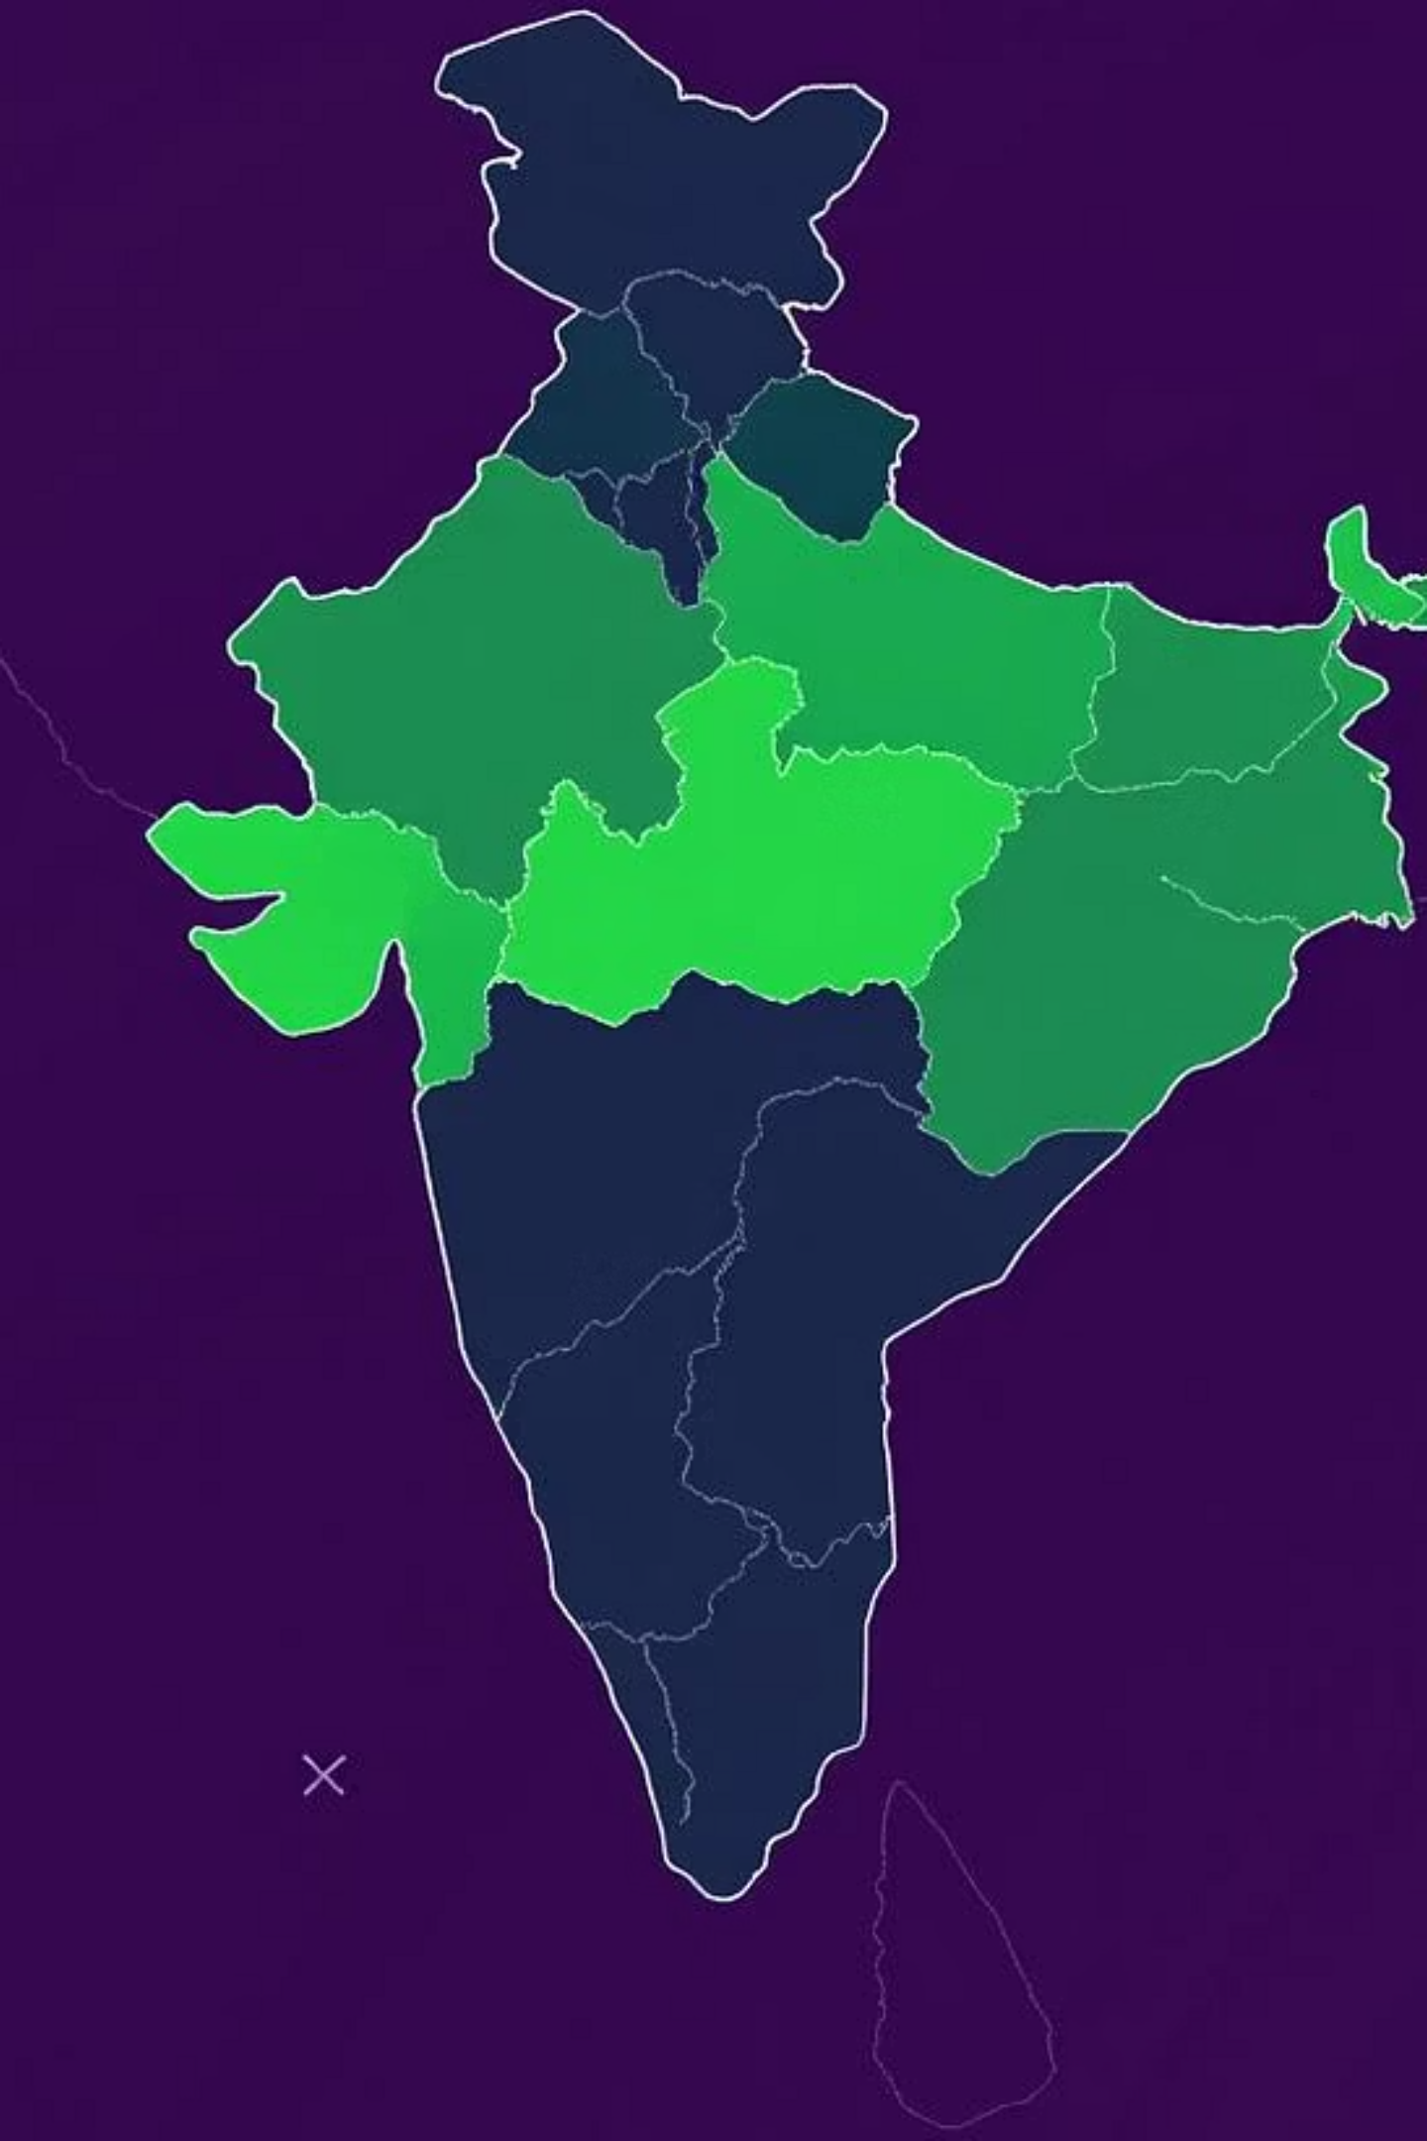
Addressing the EV Adoption Challenge
India is increasingly focusing on electric mobility. To better understand and support this shift, we need to analyze electric vehicle (EV) adoption rates across different states. This analysis will provide crucial insights for policy-making and market strategies.

Slide 3
Our Core Objectives
Explore Sales Trends
Identify Key Regions
Visualize Insights
Analyze EV sales trends across all Indian states to understand regional variations.
Pinpoint top-performing and lagging regions in EV adoption.
Utilize data visualization techniques to derive actionable insights from the sales data.

Slide 4
Understanding Our Dataset
Our analysis is based on a comprehensive dataset sourced from Kaggle. This dataset includes various attributes essential for our study:
State Name: Identifies the specific Indian state.
Vehicle Category: Differentiates between vehicle types (e.g., 2W, 4W).
Fuel Type: Specifies the fuel used (e.g., Electric, Petrol).
Sales Count: Records the number of vehicles sold.
The dataset covers multiple years and various vehicle types, providing a broad overview of the Indian automotive market.

Slide 5

Data Preparation: Ensuring Accuracy
Before analysis, rigorous data preprocessing was performed to ensure accuracy and reliability. Key steps included:
Cleaning missing values and removing duplicate entries.
Normalizing state names for consistency across the dataset.
Filtering the data specifically for Electric Vehicles only, to focus on our core objective.

Slide 6
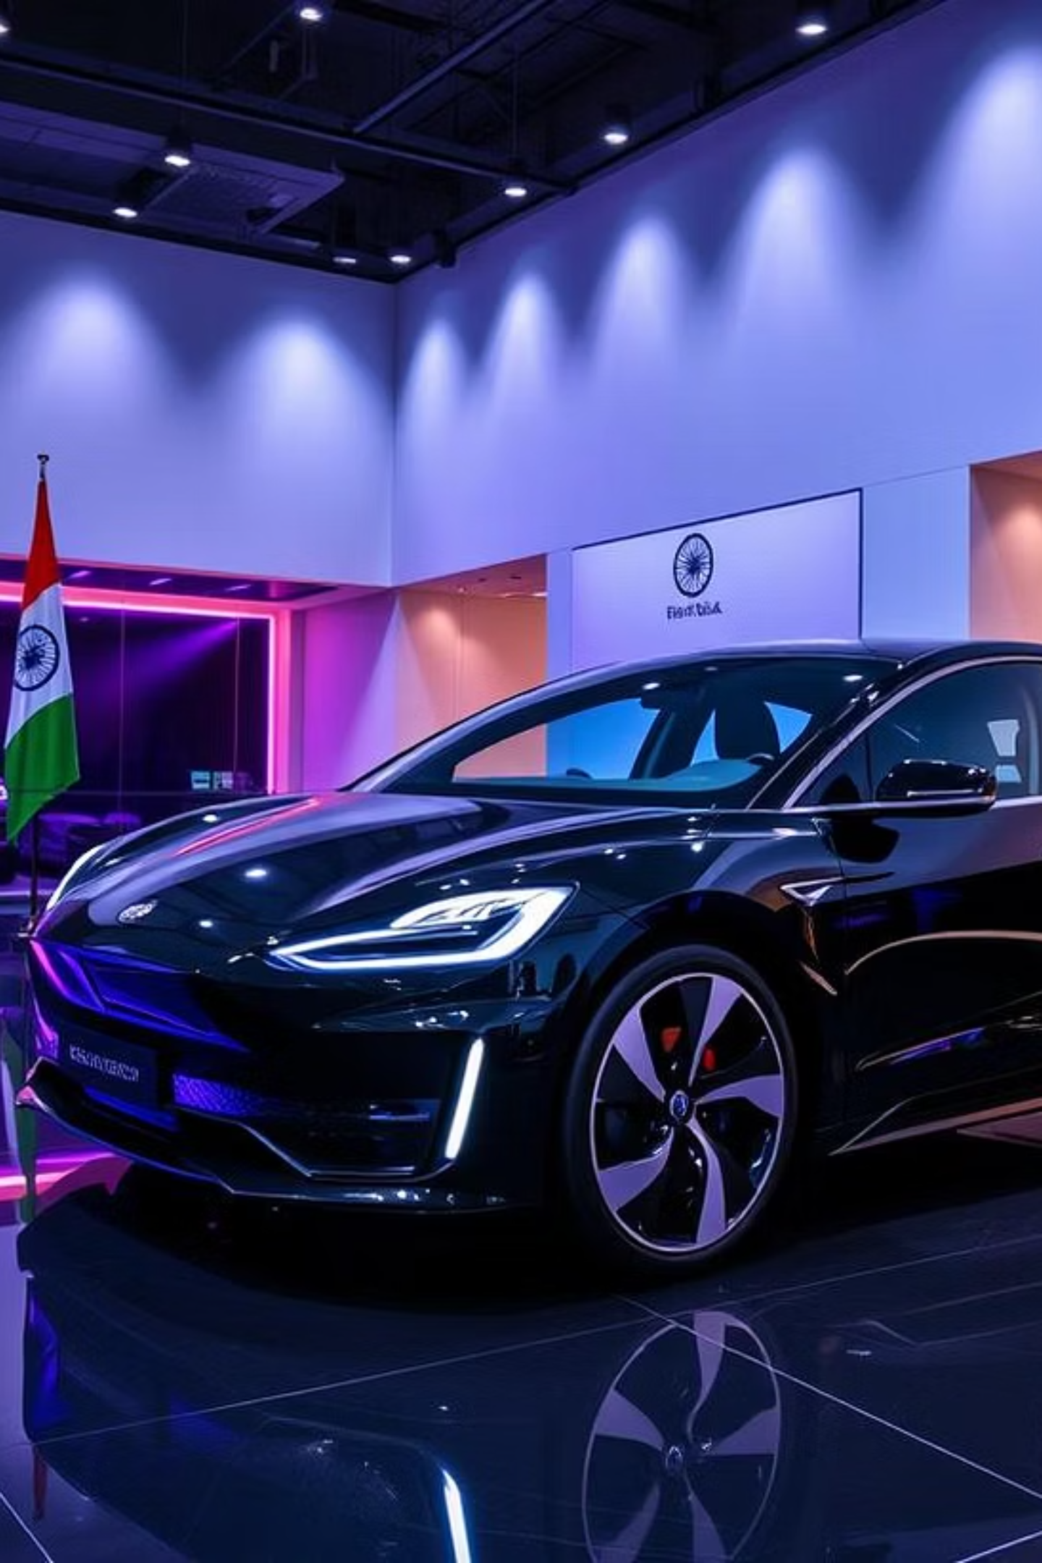
Key Findings from Exploratory Data Analysis
Our exploratory data analysis revealed significant trends and patterns in EV sales across India.
Identified the top 5 states with the highest EV sales, highlighting regional leaders.
Visualized year-on-year growth to observe the adoption trajectory over time.
Compared sales by vehicle category, such as 2-wheelers (2W) versus 4-wheelers (4W), to understand market segmentation.

Slide 7
Insights: Leaders and Trends
Leading States
Post-2020 Growth
E-Rickshaw Impact
Delhi and Karnataka consistently lead in electric vehicle sales, indicating strong adoption in these regions.
There has been a steady and significant rise in EV adoption across India, particularly noticeable after 2020.
E-rickshaws constitute a substantial share of EV sales in several states, contributing significantly to overall adoption.

Slide 8

Conclusion: Uneven but Growing Adoption
Our analysis concludes that electric vehicle adoption in India is growing, but the growth is uneven across states. Key states are driving the current momentum, highlighting the need for targeted policy incentives to accelerate adoption nationwide and ensure equitable distribution of EV benefits.

Slide 9
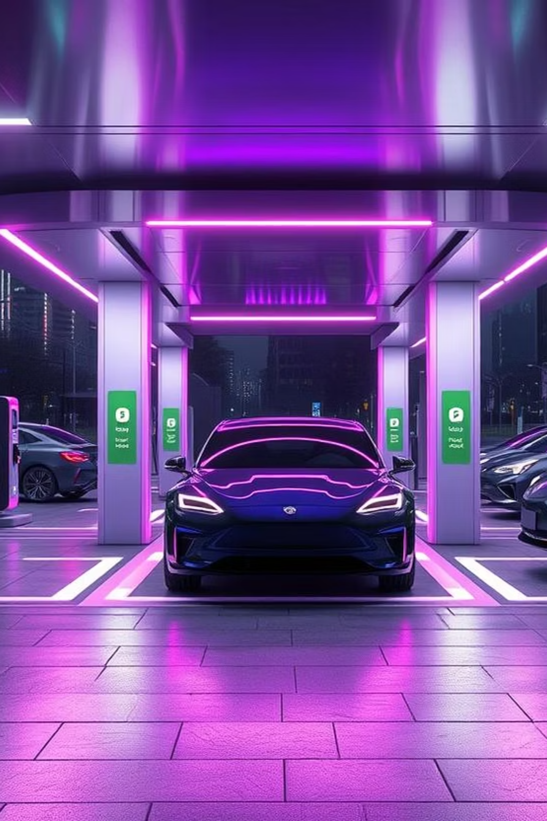
Future Work & Next Steps
To further enhance our understanding and predictive capabilities, our future work will focus on:
Conducting time series forecasting of EV sales to predict future trends and demand.
Integrating charging infrastructure data to analyze its correlation with EV adoption rates.
Examining the correlation between state-wise policies and EV sales to identify effective regulatory frameworks.

